Slide 1




CMSC204
Kartchner
V(StateGraph) = {Oregon, Alaska, Texas, Hawaii, Vermont, NewYork, California}
E(StateGraph) = {(Alaska, Oregon), (Hawaii, Alaska), (Hawaii, Texas), (Texas, Hawaii), (Hawaii, California), (Hawaii, New York), (Texas, Vermont), (Vermont, California), (Vermont, Alaska)}
1. Draw the StateGraph
Alaska
Oregon
Vermont
Hawaii
California
Texas
New york
{Oregon, Alaska, Texas, Hawaii, Vermont, NewYork, California}
{(Alaska, Oregon), (Hawaii, Alaska), (Hawaii, Texas), (Texas, Hawaii), (Hawaii, California),
(Hawaii, New York), (Texas, Vermont), (Vermont, California), (Vermont, Alaska)}
NO
YES
TEXAS

Slide 2

Alaska
California
Hawaii
New York
Oregon
Texas
Vermont
a. Show the adjacency matrix that would describe the edges in the graph. Store the vertices in alphabetical order
States
Alaska
California
Hawaii
New York
Oregon
Texas
Vermont
0 0 0 0 1 0 0
0 0 0 0 0 0 0
1 1 0 1 0 1 0
0 0 0 0 0 0 0
0 0 0 0 0 0 0
0 0 1 0 0 0 1
1 1 0 0 0 0 0
3. b. Show the adjacency lists
that would describe the edges in the graph
Alaska
California
Hawaii
New York
Oregon
Texas
Vermont
Oregon
Alaska
California
New York
Texas
Hawaii
Vermont
Alaska
California

Slide 3
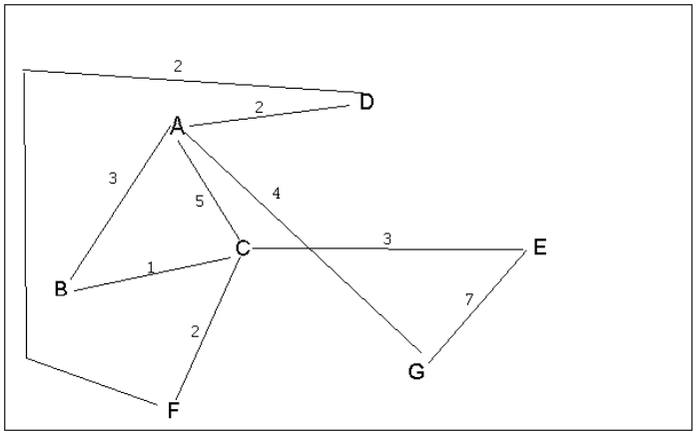
4 a. Which of the following lists the graph nodes in depth first order beginning with E?
A) E, G, F, C, D, B, A
B) G, A, E, C, B, F, D
C) E, G, A, D, F, C, B
D) E, C, F, B, A, D, G
4 b. Which of the following lists the graph nodes in breadth first order beginning at F?
A) F, C, D, A, B, E, G
B) F, D, C, A, B, C, G
C) F, C, D, B, G, A, E
D) a, b, and c are all breadth first traversals

Slide 4
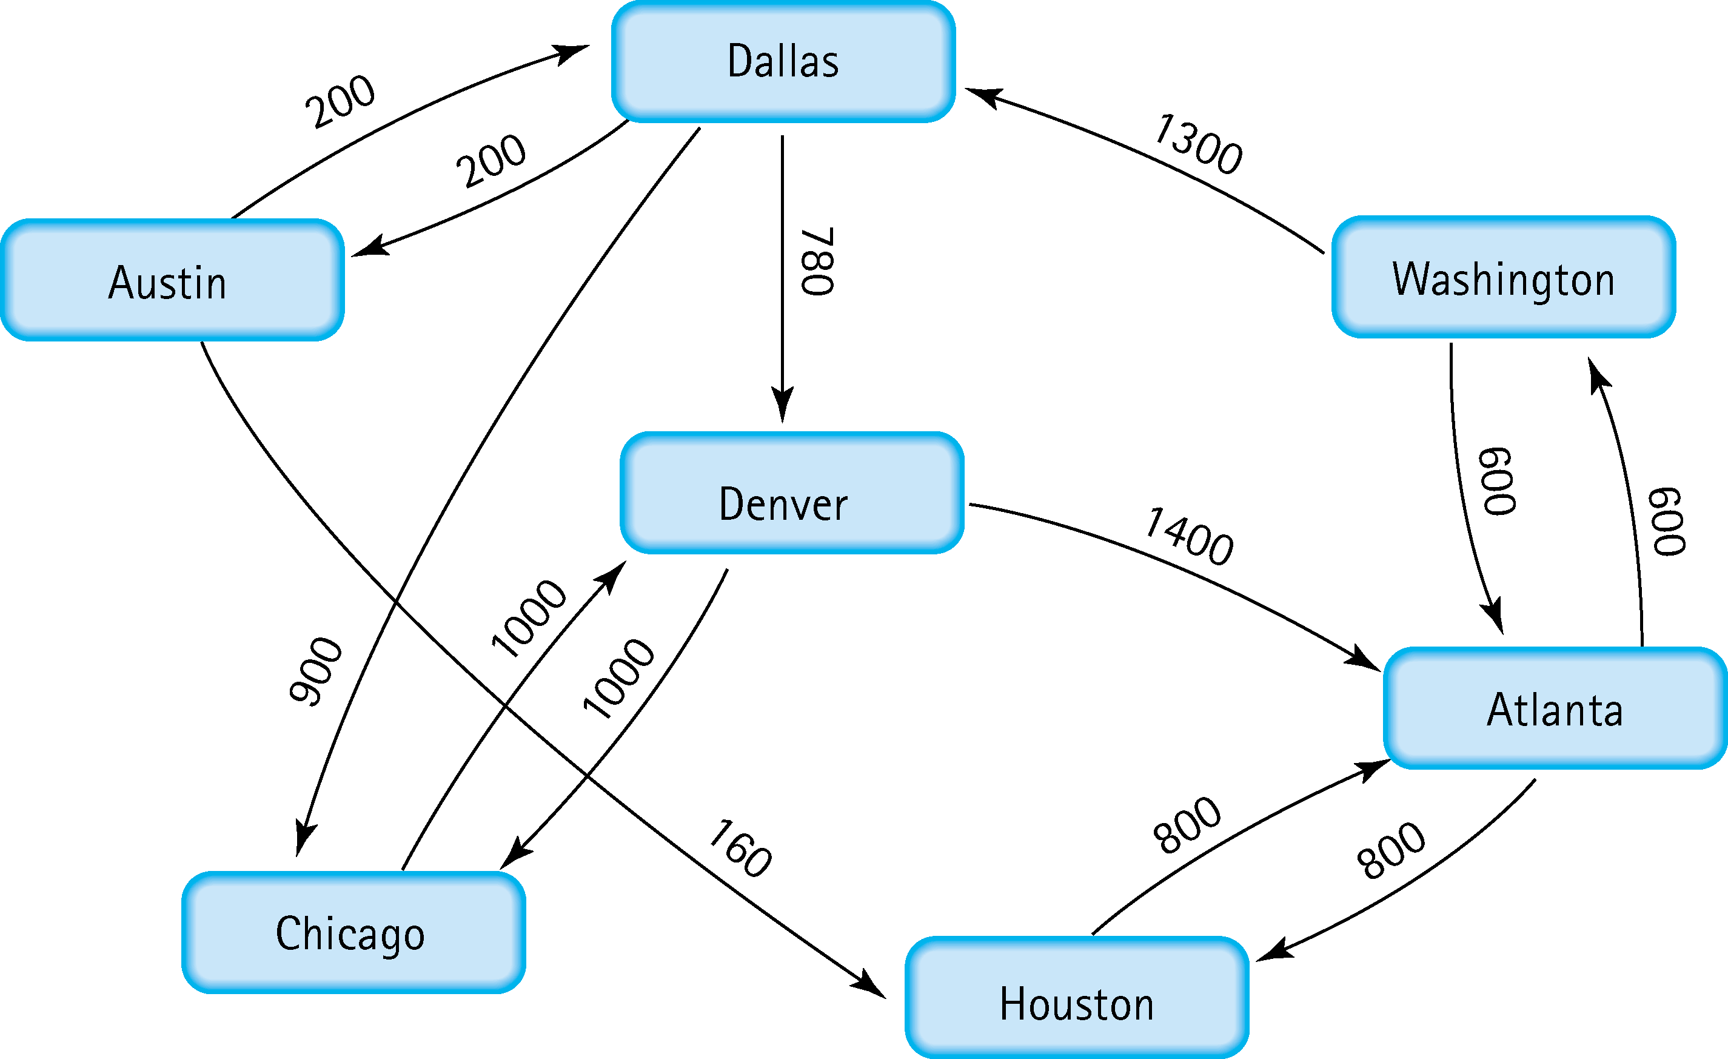
5. Find the shortest distance from Atlanta to every other city
Atlanta -> Washington (600)
Atlanta -> Houston (800)
Atlanta -> Washington -> Dallas (1300)
Atlanta ->Washington -> Dallas -> Denver (2680)
Atlanta ->Washington -> Dallas -> Chicago (2800)
Atlanta ->Washington -> Dallas ->Austin (2100)

Slide 5
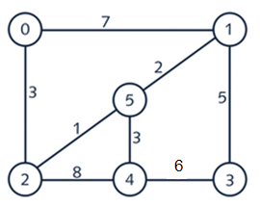
6. Find the minimal spanning tree using Prim’s algorithm. Use
0 as the source vertex . Show the steps.
0 -> 2 cost: 3
2 -> 5 cost: 1
5 -> 1 cost: 2
5 -> 4 cost: 3
1 -> 3 cost: 5
0,2,5,1,4,3
Total cost: 14

Slide 6
7. Find the minimal spanning tree using Kruskal’s algorithm.
Show the weights in order and the steps.
2 -> 5 cost: 1
5 -> 1 cost: 2
0 -> 2 cost: 3
5 -> 4 cost: 3
1 -> 3 cost: 5
2,5,1,0,2,4,3
Total cost: 14

Slide 7
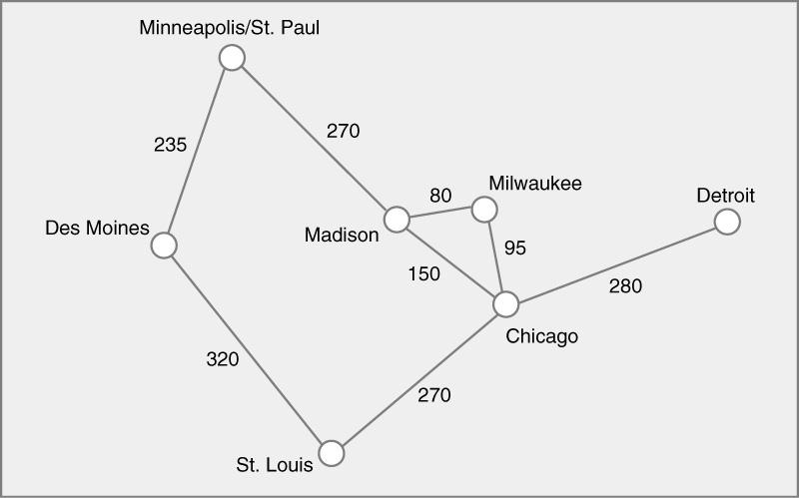
8. Find the minimal spanning tree using the algorithm you prefer. Use
Minneapolis/St. Paul as the source vertex
minn/stPaul -> Des Moines Cost:235
Minn/stPaul -> Madison Cost: 270
Madison -> Milwaukee Cost 80
Milwaukee -> Chicago Cost: 95
Chicago -> St.Louis Cost: 270
Chicago -> Detroit Cost: 280
Minn/stPaul, Des Moines, Madison, Milwaukee, Chicago,
St. Louis, Detroit
Total cost: 1230

Slide 8
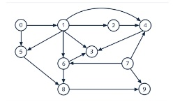
9. List the nodes of the graph in a breadth first topological ordering. Show the
steps using arrays predCount, topologicalOrder and a queue
0 1 5 2 6 8 9 4 3

Slide 9
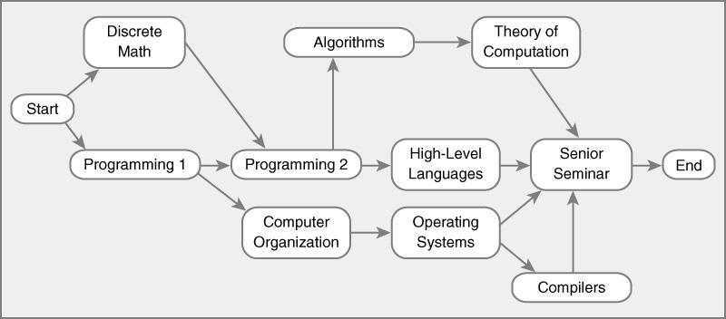
10. List the nodes of the graph in a breadth first topological ordering.
Start->Discrete math->Prog1->Prog2->Comp org.->Algorithms-> High-level lang.
->Theory of comp.->Operating Systems->compilers->senior seminar -> end

